Slide 1
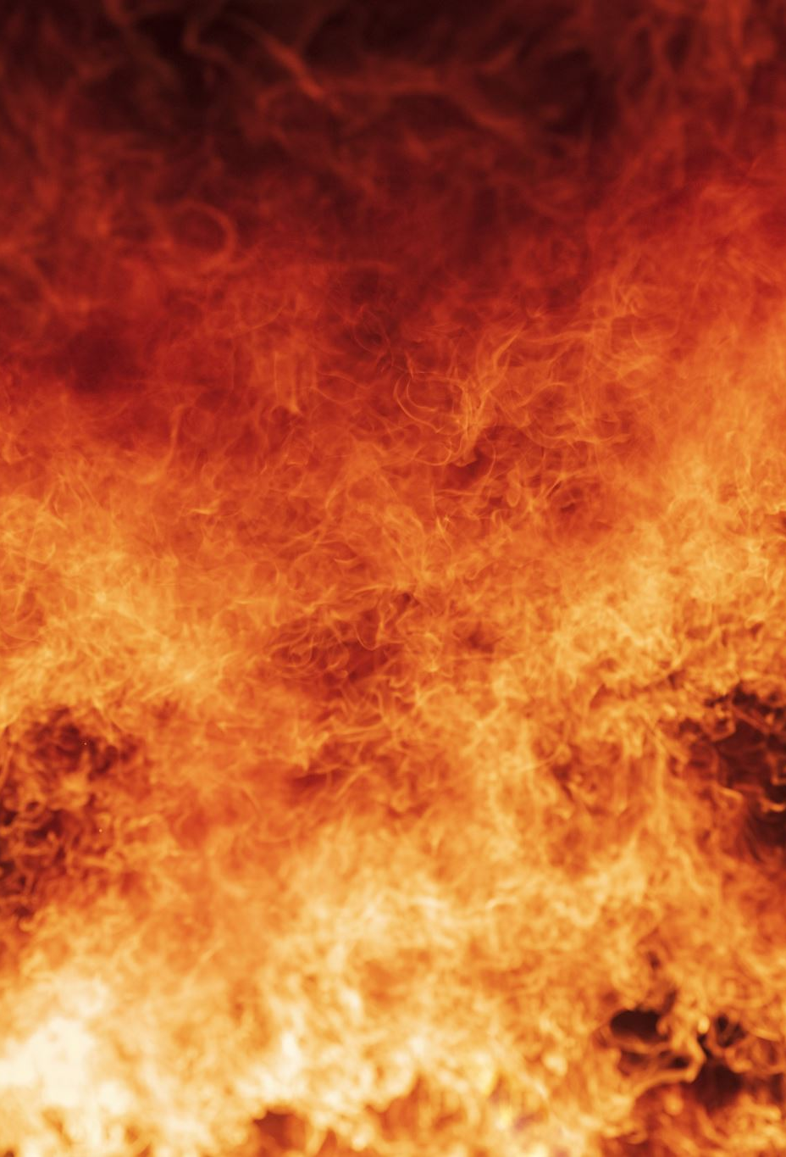
Fire and Smoke Detection Using Multimodal Fusion with Explainability
Final Year Capstone Project - Review 1
Team Members: Bhavya Chanana – 21BCE1414, Atharva Bodke – 21BAI1855
Faculty Guide: Dr. Geetha S.

Slide 2

Introduction
a) Statement of Problem/Challenges (Research Question)
Problem: Early detection of fire and smoke using satellite imagery, weather, and terrain data.
Challenges: Data alignment, class imbalance, and model interpretability.
b) Background, Context, and Significance of Study
Importance of early fire detection to prevent large-scale damage.
Use of advanced technologies like CNN-Transformer fusion for accurate detection

Slide 3
Problem Statement
Develop a system to detect fire and smoke using multimodal data fusion (satellite, weather, terrain) with explainability.
Why it matters:
Early detection can save lives, reduce environmental damage, and minimize economic losses.

Slide 4
Research Challenges
Data Alignment: Challenges in aligning data from different resolutions.
Class Imbalance: Handling the imbalance between fire and non-fire data.
Model Interpretability: Ensuring the model's decisions are explainable

Slide 5

Research Objective
Novelty: Detect fire and smoke using satellite imagery, weather, and terrain data.
To create a CNN-Transformer fusion model that provides fire/smoke probability with region-specific explanations.
Multimodal Fusion Architecture :
CNN (MobileNetV3): Extracts spatial-spectral features from satellite imagery (e.g., SWIR, NIR bands).
Transformer: Processes sequential/non-spatial weather/terrain data (ERA5, LANDFIRE) and enables cross-modal attention.

Slide 6
Explainability Integration
Grad-CAM: Highlight fire regions in satellite imagery (e.g., red zones for high fire probability).
Attention Weights: Quantify contributions of weather variables (e.g., low humidity → higher fire risk) and terrain features (e.g., slope → fire spread).

Slide 7
Methodology - Modules/Algorithms
Satellite Encoder:
MobileNetV3 for extracting fire-relevant features from multispectral satellite imagery.
Weather/Terrain Encoder:
Transformer/MLP for processing weather (ERA5) and terrain (LANDFIRE) data.
Cross-Modal Fusion:
Transformer-based attention mechanism to dynamically weigh modalities (e.g., prioritize SWIR in dry conditions).
Visuals:
Diagram of the model architecture (Satellite Encoder → Weather/Terrain Encoder → Cross-Modal Fusion).

Slide 8
Methodology - Data Collection Approaches/Strategies
a) Advantage of Strategy:
Comprehensive data collection from multiple sources (Sentinel-2, ERA5, LANDFIRE).
b) Limitation of Strategy:
Challenges in aligning data from different resolutions.
c) Potential Risk:
Data privacy and ethical issues in data collection.
d) Ethical Issues:
Ensuring data anonymization and compliance with ethical standards.
Visuals:
Diagram of data collection process (e.g., Sentinel-2 → ERA5 → LANDFIRE).

Slide 9
Methodology - Data Analysis Approaches
Explainability:
Use of Grad-CAM to highlight fire-relevant regions in satellite images.
Attention weights to show weather/terrain contributions to the model’s decisions.
Visuals:
Example of Grad-CAM output on a satellite image.
Diagram of attention weights in the model.

Slide 10
Proposed System
Overview:
The proposed system uses multimodal data fusion (satellite, weather, terrain) to detect fire and smoke with explainability.
Key Features:
Real-time fire detection.
Region-specific explanations for model predictions.

Slide 11
Proposed System - List of Modules
Modules:
Satellite Image Processing (MobileNetV3).
Weather & Terrain Processing (Transformer/MLP).
Cross-Modal Fusion (Transformer-based attention).

Slide 12
Proposed System - Explanation of Modules (Satellite Image Processing)
Details:
MobileNetV3 is used to extract fire-relevant features from multispectral satellite imagery (e.g., SWIR, NIR bands).
Visuals:
Diagram of MobileNetV3 architecture.
Example of satellite image processing.

Slide 13
Los Angeles

Slide 14
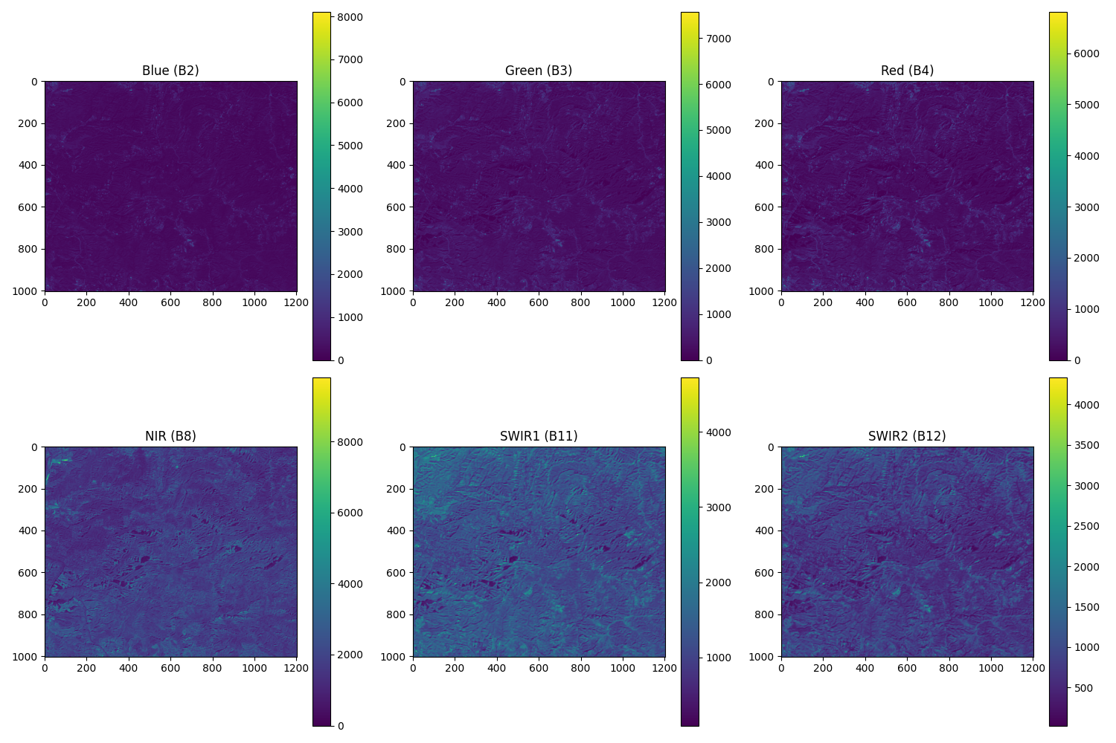
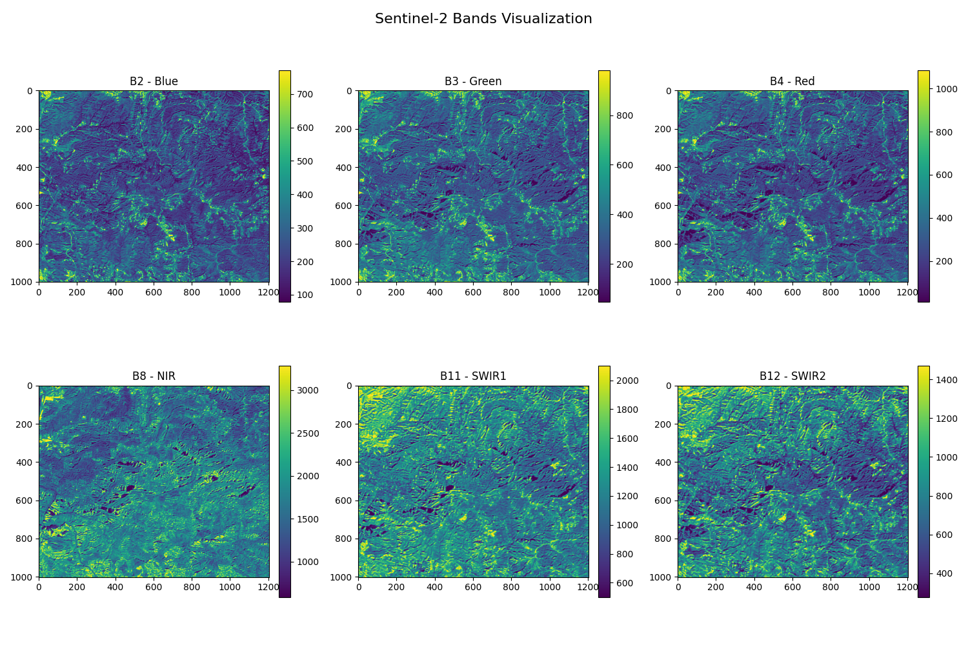
Proposed System - Explanation of Modules (Satellite Image Processing) SANTA MONIcA

Slide 15

Proposed System - Explanation of Modules (Weather & Terrain Processing)
Purpose: Convert weather (ERA5) and terrain (LANDFIRE) data into feature embeddings for fusion with satellite data.
Key Inputs:
ERA5: Hourly weather variables (temperature, humidity, wind speed).
LANDFIRE: Terrain attributes (elevation, slope, fuel type, canopy cover).

Slide 16
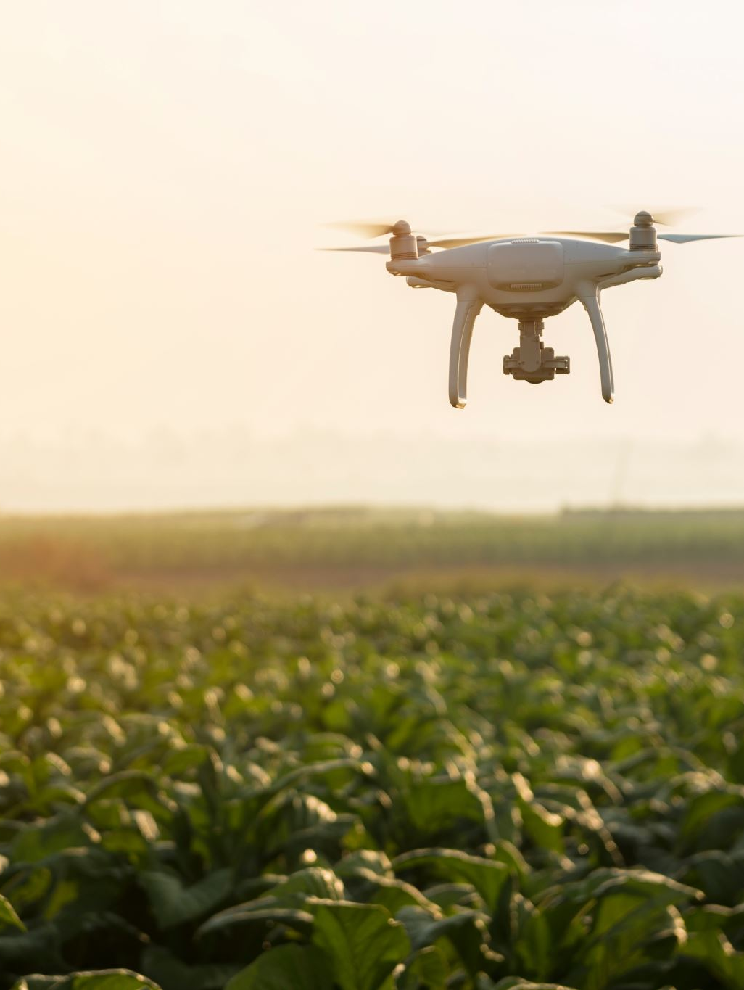
Drone-Based Fire & Smoke Detection
Overview:
Drone-based fire detection offers real-time monitoring, faster response times, and high-resolution imagery compared to satellite data.
Drones can capture thermal and visible light images, improving detection accuracy.
Multimodal approach: Combining drone images/videos with weather and terrain data for robust detection.
Why Use Drones?
Faster data collection compared to satellites.
Ability to monitor specific areas on demand.
Thermal cameras detect heat signatures of fires.
High mobility in difficult terrains.

Slide 17

Proposed Model Architecture- Drones
Input Data:
Drone Images & Videos – RGB & thermal imagery.
Weather Data – Temperature, humidity, wind speed (from ERA5 or sensors).
Terrain Data – Elevation, vegetation density (from LANDFIRE or drone LiDAR).
Model Components:
Image Encoder: Vision Transformer (ViT) or MobileNetV3 for drone images.
Video Processing: 3D CNN or ConvLSTM for analyzing temporal features.
Weather/Terrain Encoder: Transformer or MLP for structured data.
Cross-Modal Fusion: Transformer-based attention mechanism to combine image, video, and tabular data.
Output: Fire/Smoke probability with explainability.

Slide 18
Preprocessing Drone Images & Video Frames
Steps for Drone Imagery:
Convert images to a uniform resolution (e.g., 256x256 or 512x512 pixels).
Normalize pixel values for consistency.
Apply augmentation (rotation, flipping, brightness adjustments) for robustness.
Extract thermal features if available.
Steps for Video Processing:
Convert video to frame sequences.
Use Optical Flow or Frame Differencing to detect motion in smoke.
Apply a 3D CNN (e.g., I3D, SlowFast) for spatiotemporal analysis.
Extract keyframes to reduce computational load.

Slide 19
Multimodal Fusion with Weather & Terrain Data
Fusion Strategies:
Early Fusion: Combine features from all sources before feeding into the model.
Late Fusion: Process each modality separately and merge at the decision stage.
Cross-Attention Transformer: Learn relationships between modalities via attention.
Explainability Techniques:
Grad-CAM for Drone Images: Visualizes heat maps on detected fire/smoke regions.
Attention Maps for Weather/Terrain Data: Highlights important environmental factors contributing to fire risk.
Final Output:
Fire probability score with highlighted risk areas.
Actionable insights for firefighters and emergency responders.

Slide 20
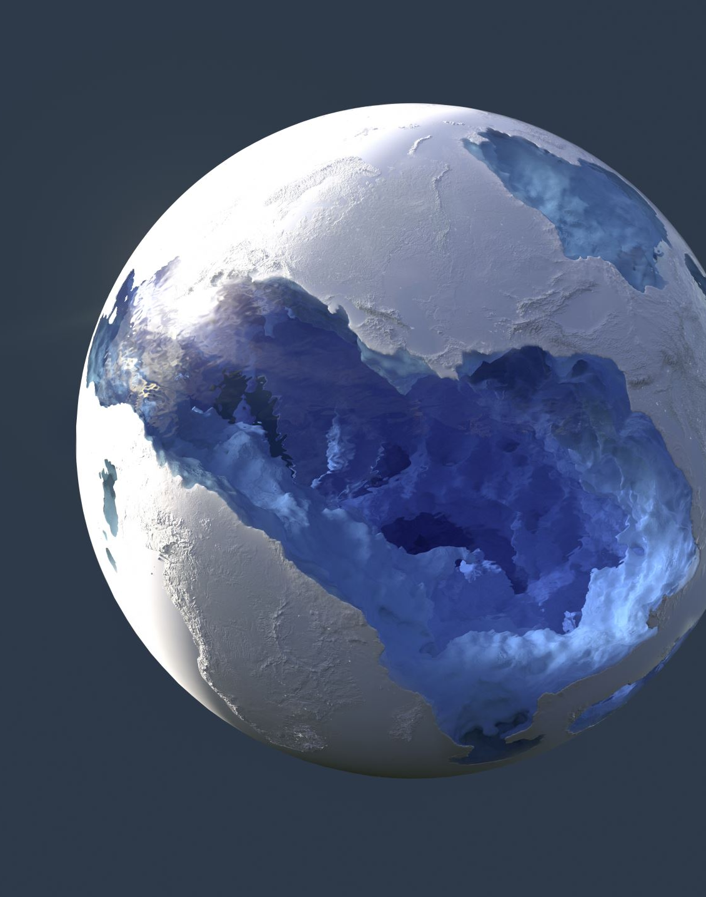
FUTURE WORK
Global Live Fire Detection
Build a Google Earth-like interface for real-time forest fire monitoring worldwide.
Interactive Fire Maps
Display fire probability heatmaps and region-specific explanations (e.g., "High risk due to dry weather").
Global Impact
Empower governments, NGOs, and firefighters with real-time data for rapid response.

